Slide 1
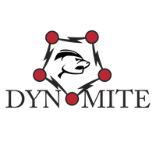

Making Non-Distributed Databases, Distributed
Shailesh Birari
Ioannis Papapanagiotou, PhD
Cloud Database Engineering

Slide 2
Dynomite Ecosystem
Dynomite
Dynomite-manager
Dyno client

Slide 3
Cloud Database Engg (CDE) Team
Develop and operate data stores in AWS
Cassandra, Dynomite, Elastic Search, RDS, S3
Ensure availability, scalability, durability and latency SLAs
Database expertise, client libraries, tools and best practices
Notes:
One Stop Shop for All Things Databases

Slide 4
Problems & Observations
Cassandra not a speed demon (reads)
Needed a data store:
Scalable & highly available
High throughput, low latency
Active-active multi datacenter replication
Usage of Redis increasing:
Netflix use case is active-active, highly available
Does not have bi-directional replication
Cannot withstand a Monkey attack
Notes:
Our business use case is to stream movies at any cost. Hence we moved from the SQL to Cassandra in order to have high availability.
We are very sensitive to 99th latencies,
Cassandra
Started Migrating to NoSQL
Quickly Became the Defacto standard for data storage
Scaled out Cassandra to reduce data per node and reduce latency
Definitely Not economical. Needed something in memory to meet the throughput and latency
Needed:
Typical deployment is in 3 data centers and 3 availability zones in each
Redis:
Kong exercises: Monkey, Gorilla and Kong

Slide 5
What is Dynomite?
A generic layer that can be used with many key-value storage engines like Redis, Memcached, LMDB, etc
Focus: performance, cross-datacenter active-active replication and high availability
Features: node warmup (cold bootstrapping), tunable consistency, S3 backups/restores
Status: Open source, fully integrated with existing NetflixOSS ecosystem
Notes:
Two types of use cases : As a Cache and As a datastore

Slide 6
Dynomite @ Netflix
Running around 1.5 years in PROD
~1000 customer facing nodes
1M OPS at peak
Largest cluster: 6TB
Quarterly upgrades in PROD
Notes:
Use Master branch of github since that is the stable one and thats what we run in production

Slide 7
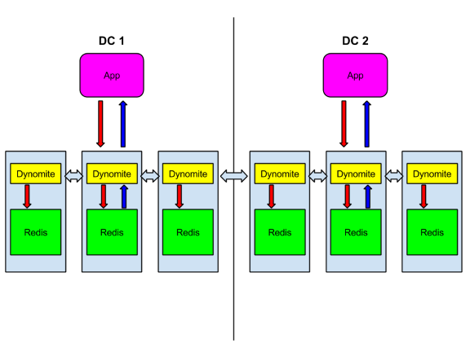
Dynomite Overview
Layer on top of a non-distributed key value data store
Peer-peer, Shared Nothing
Auto Sharding
Multi-datacenter
Linear scale
Replication(Encrypted)
Gossiping
Notes:
Peer to peer, Shared nothing architecture
Symmetry: All nodes are same, no concept of a leader or a master
Symmetry: every node has the same responsibilities, so it is easier to manage and maintain
highly decentralized, loosely coupled, service oriented architecture that can scale.
data can be stored even if network is flapping or data centers are destroyed

Slide 8
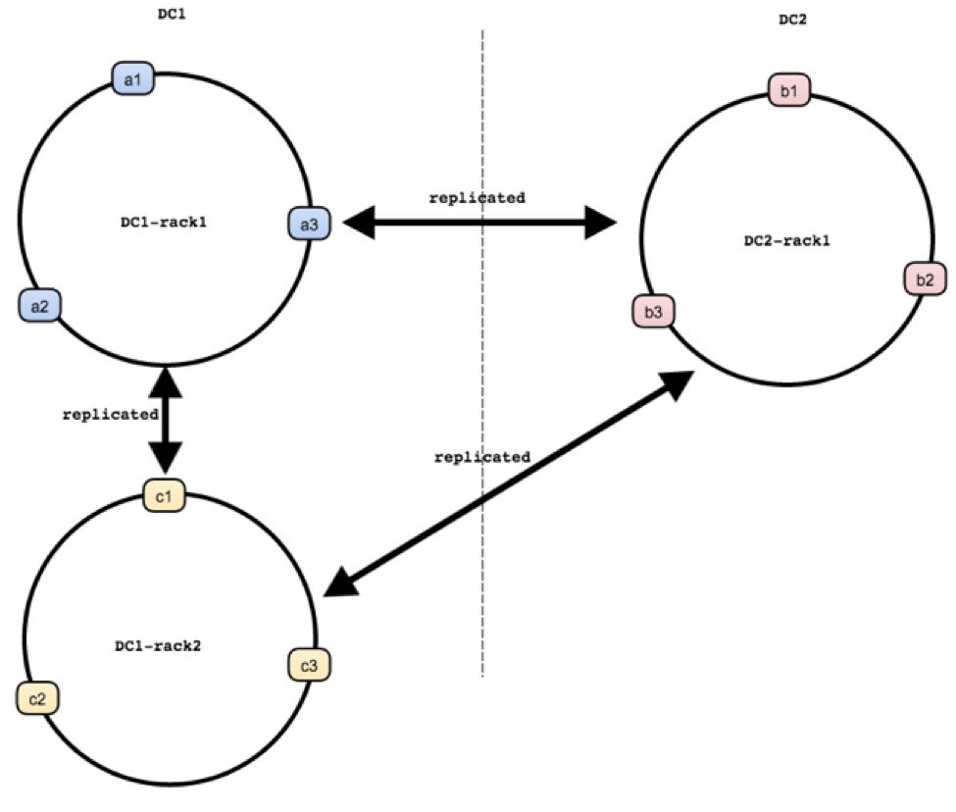
Topology
Each rack contains one copy of data, partitioned across multiple nodes in that rack
Multiple Racks == Higher Availability (HA)
Notes:
All nodes know the topology in the system

Slide 9
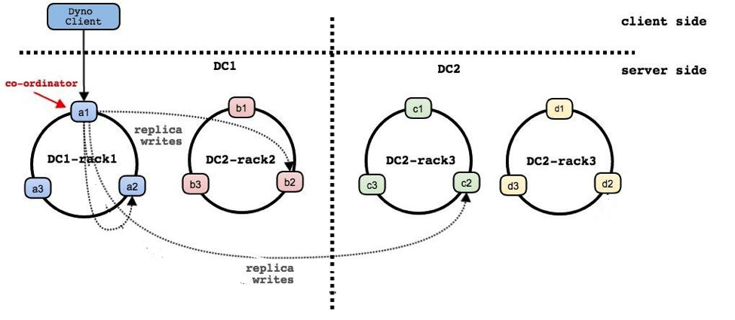
Replication
A client can connect to any node on the Dynomite cluster when sending requests.
If node owns the data,
data are written in local data-store and asynchronously replicated.
If node does not own the data
node acts as a coordinator and sends the data in the same rack & replicates to other nodes in other racks and DC.
Notes:
Fix errors in arrows - Minh has source :)
and rack names

Slide 10
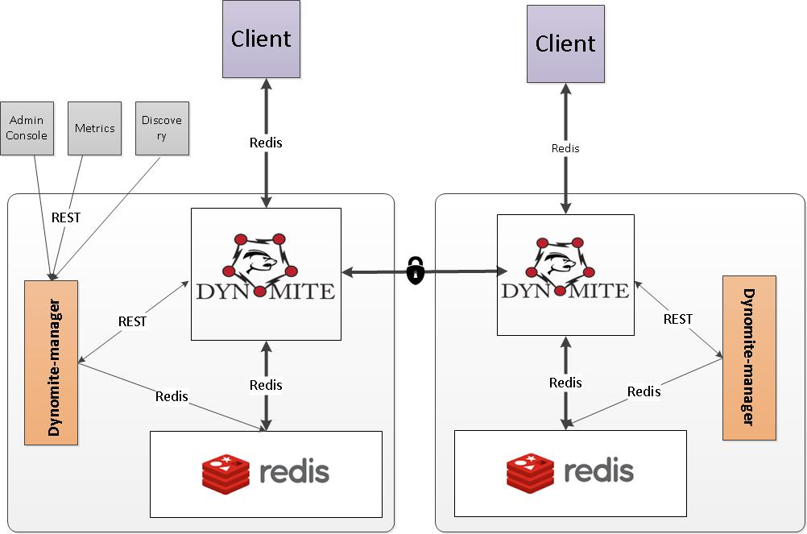
The Dynomite Ecosystem
Notes:
Each Dynomite node (e.g., a1 or b1 or c1) has a Dynomite process co-located with the datastore server, which acts as a proxy, traffic router, coordinator and gossiper.
Dynomite manager
Monitoring Dynomite, Redis
Responsible for publishing Redis and Dynomite Metrics
Handles Cold bootstrapping, backups, restores

Slide 11
Consistency
DC_ONE
Reads and writes are propagated synchronously only to the node in local rack and asynchronously replicated to other racks and data centers
DC_QUORUM
Reads and writes are propagated synchronously to quorum number of nodes in the local region and asynchronously to the rest
Consistency can be configured dynamically for read or write operations separately (cluster-wide)

Slide 12
Performance Setup
Instance Type:
Dynomite: r3.2xlarge (1Gbps)
Pappy/Dyno: m2.2xls (typical of an app@Netflix)
Replication factor: 3
Deployed Dynomite in 3 zones in us-east-1
Every zone had the same number of servers
Demo app used simple workloads key/value pairs
Redis: GET and SET
Payload
Size: 1024 Bytes
80%/20% reads over writes
Notes:
Netflix Tech Blog
Focus on what we have, not to show how fast we are
Mainly useful in sizing clusters while deploying dynomite for customers

Slide 13
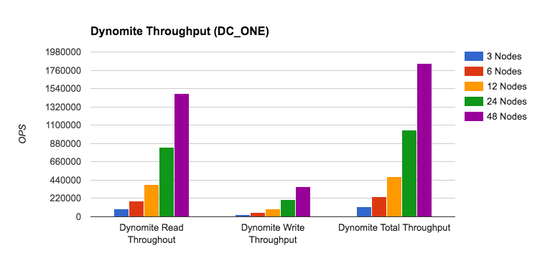
Performance (Dynomite Speed)
Throughput scales linearly with number of nodes.
Dynomite can reach >1Million Client requests with ~24 nodes.
Notes:
Fix: identify graphs better

Slide 14
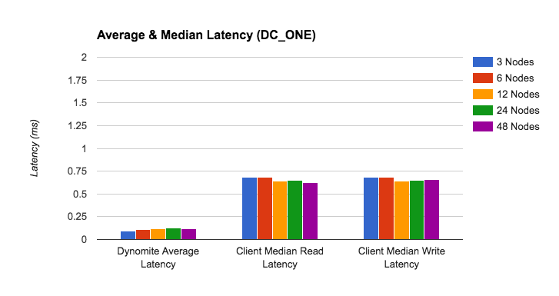
Performance (Latency - average/P50)
Dynomite’s latency on average is 0.16ms.
Client side latency is 0.6ms and does not increase as the cluster scales up/down
Notes:
Dynomite contribution is very less and majority of latency is taken by the network

Slide 15
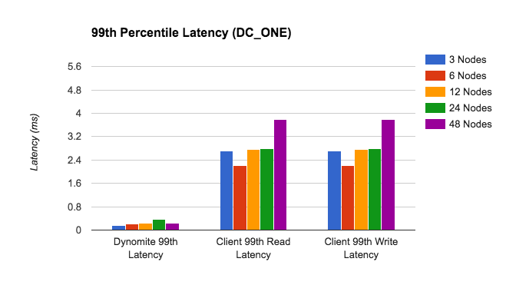
Performance (Latency - P99)
The major contributor to latency at P99 is the network.
Dynomite affects <10%

Slide 16
Dynomite-manager
Token management for multi-region deployments
Support AWS environment
Automated security group update in multi-region environment
Monitoring of Dynomite and the underlying storage engine
Node cold bootstrap (warm up)
S3 backups and restores
REST API

Slide 17
Dynomite-manager: warm up
Dynomite-manager identifies which node has the same token in the same DC
Sets Redis to “Slave” mode of that node
Checks for peer syncing
difference between master and slave offset
Once master and slave are in sync, Dynomite is set to allow write only
Dynomite is set back to normal state
Checks for health of the node - Done!
Notes:
Picture is incorrect -- DC2-rack2 should be DC1

Slide 18
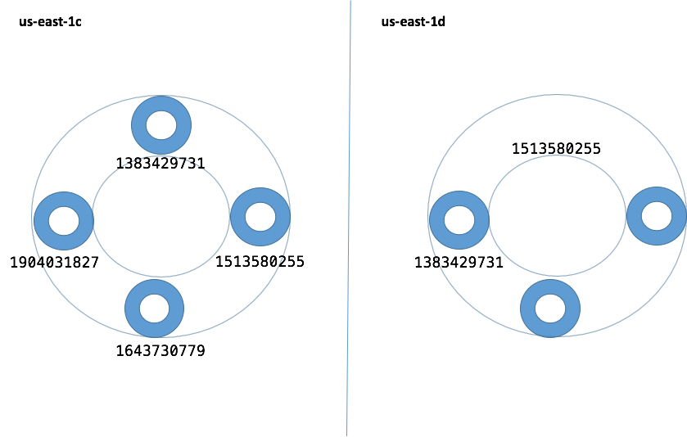
Warm up (node terminated)
Notes:
Picture is incorrect -- DC2-rack2 should be DC1

Slide 19
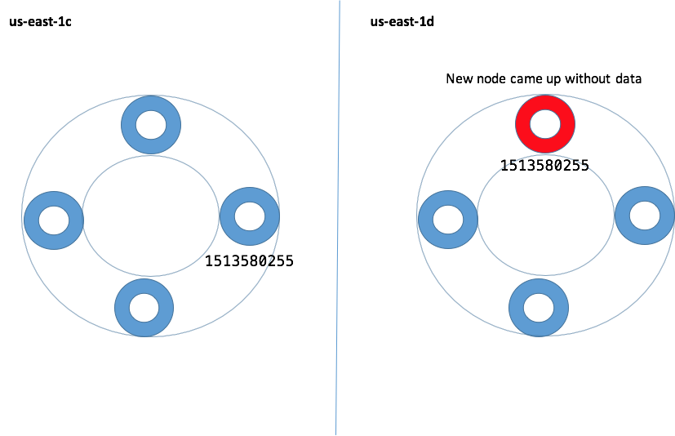
Warm up (auto-scale)
Notes:
Picture is incorrect -- DC2-rack2 should be DC1

Slide 20
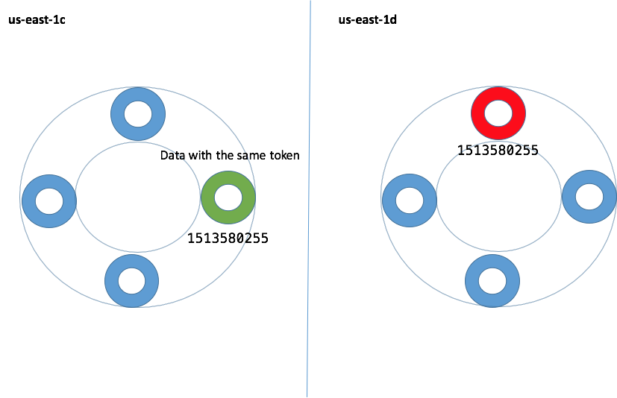
Warm up (node with same token)
Notes:
Picture is incorrect -- DC2-rack2 should be DC1

Slide 21
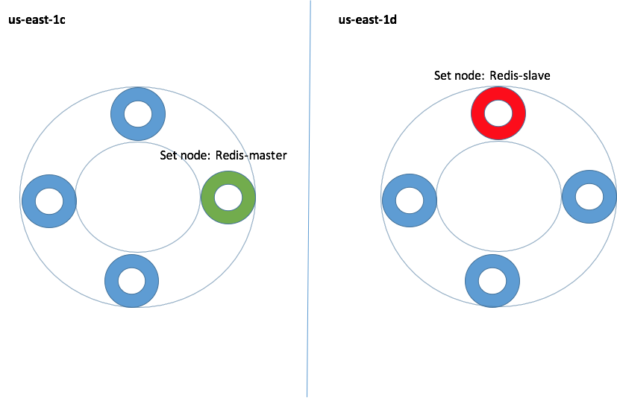
Warm up (Redis replication)
Notes:
Picture is incorrect -- DC2-rack2 should be DC1

Slide 22
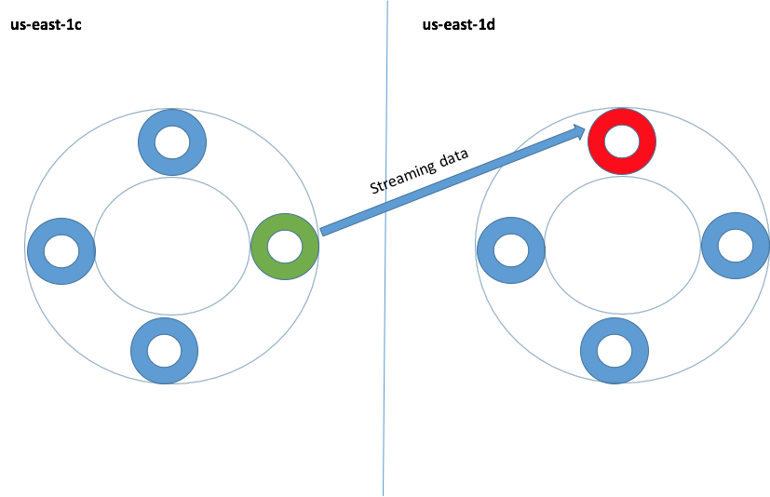
Warm up (Streaming data)
Notes:
Picture is incorrect -- DC2-rack2 should be DC1

Slide 23
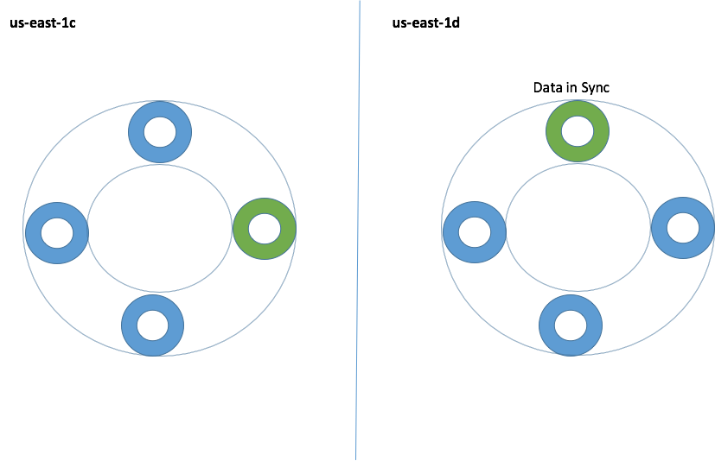
Warm up (Nodes in sync)
Notes:
Picture is incorrect -- DC2-rack2 should be DC1

Slide 24
Dynomite: S3 backups/restores
Why?
Disaster recovery
Data corruption
How?
Redis dumps data on the instance drive
Dynomite-manager sends data to S3 buckets
Data per node are not large so no need for incrementals.
Use case:
clusters that use Dynomite as a storage layer
Not enabled in clusters that have short TTL or use Dynomite as a cache
Notes:
Picture is incorrect -- DC2-rack2 should be DC1

Slide 25
Dynomite S3 backups (operation)
Perform backup
Dynomite-manager performs it on a pre-defined interval
Dynomite-manger REST call:
curl http://localhost:8080/REST/v1/admin/s3backup
Perform a Redis BGREWRITEAOF or BGSAVE.
Check the size of the persisted file. If the size is zero, which means that there was an issue with Redis or no data are there, then we do not perform S3 backups
S3 backup key: backup/region/clustername-ASG/token/date

Slide 26
Dynomite S3 restores
Perform restore:
Dynomite-manager performs once it starts if configuration is enabled
Dynomite-manger REST call:
curl http://localhost:8080/REST/v1/admin/s3backup
Stop Dynomite process:
We perform this to notify Discovery that Dynomite is not accessible
Stop Redis process
Restore the data from a specific date
provided in the configuration
Start Redis process and check if the data has been loaded.
Start Dynomite and check if process is up

Slide 27
Dyno Client - Java API
Connection Pooling
Load Balancing
Effective failover
Pipelining
Scatter/Gather
Metrics, e.g. Netflix Insights

Slide 28
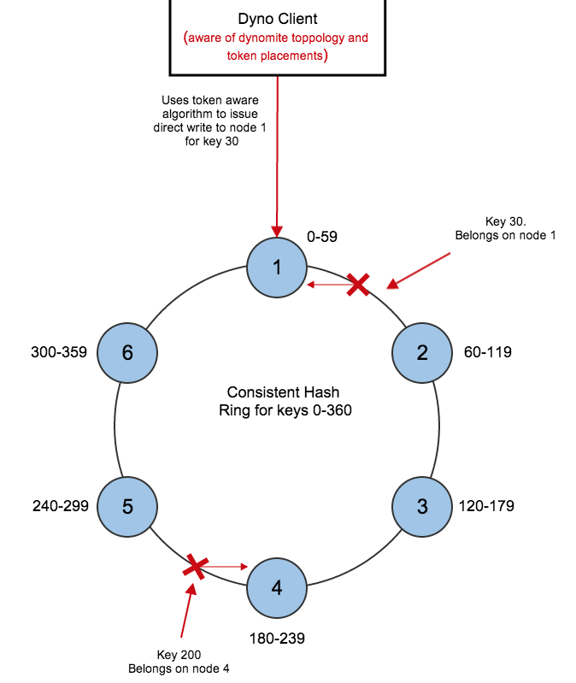
Dyno Load Balancing
Dyno client employs token aware load balancing.
Dyno client is aware of the cluster topology of Dynomite within the region,
can write to specific node using consistent hashing.

Slide 29
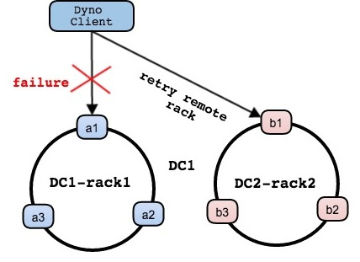
Dyno Failover
Dyno will route requests to different racks in failure scenarios.
Notes:
Picture is incorrect -- DC2-rack2 should be DC1

Slide 30
Roadmap
Multi-threaded support for Dynomite
Data reconciliation & repair v2
Dynomite-spark connector
Investigation for persistent stores
Async Dyno Client
Others….

Slide 31
More information
Netflix OSS:
https://github.com/Netflix/dynomite
https://github.com/Netflix/dyno

